Slide 1
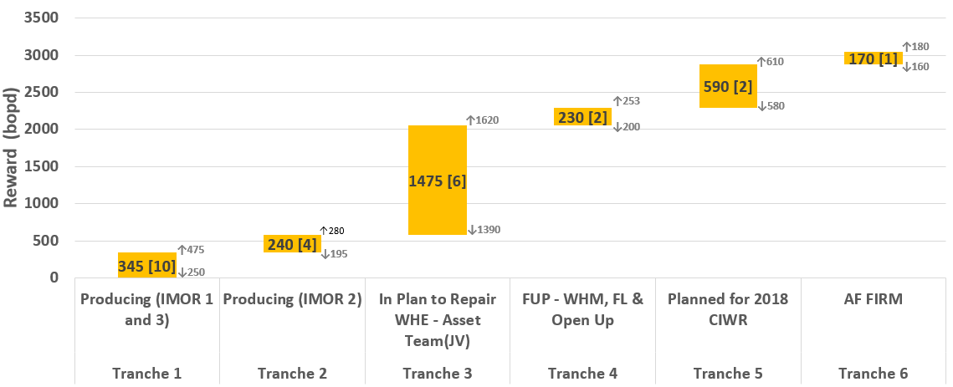

Reward Staircase and Implementation Timeline [FIRM CANDIDATES]
Tranche 1
IMOR001T:D2000X
IMOR013L:D6000A
IMOR019S:D2000X
IMOR021L:D2000X
IMOR025S:D1000X
IMOR026S:D2000X
IMOR032L:D2000X
IMOR032S:D1000X
IMOR037L:D2000X
IMOR063T:D2000X
All candidates in Firm Category has GL Mandrel and has been on GL in the past, and are selected GL Optimization
Well down on WHE/FL vandalization, AF Funded
Already identified in Strategy Workshop. WHM proposal preparation ongoing
Currently on GL, MRT required to optimize lift rate
STAIRCASE LEGEND
Tranche 2
Base Case Potential
High Case Potential
IMOR010L:D2000X
IMOR021S:D1000X
IMOR025L:D2000X
IMOR058T:D2000X
Pending Ejection from AF
Tranche 3
Conduit Count
Low Case Potential
IMOR005S:D1000X
IMOR030L:D8000N
IMOR036S:D4000X
IMOR044S:D9000N
IMOR055S:D1000X
IMOR057L:D6000P
Tranche 4
IMOR044L:E4000N
IMOR048S:D2000X
Tranche 5
Delivery Timeline (Mnths) →
14 Feb 2018 – 14 May 2018
15 May 2018 – 15 Aug 2018
16 Aug 2018 - Nov 2018
IMOR012S:D2000X
IMOR060T:D2000X
Requires FL & GLL Availability Check
Tranche 6
Range of reward (L/B/H): 2775/3050/3418 bopd
IMOR033L:D2000X
Note:
For the producing wells (i.e. Tranche 1&2): The gain is incremental due to GLOP and GLVCO (if necessary)
For non-producing conduits (i.e. Tranche 3 - 6): The reward is the expected potential of executing all activities (including GLOP) necessary to restore the conduits. These conduits flow sub-optimally without gas lift, and in some cases cannot sustain flow on NF.
Back To Why? What? Next

